Slide 1
Building conversations part 1
1

Slide 2
Lecture aims
Examine the structures of social networks
Examine Communities of Practice and their role in PR

Slide 3
Networking
Networking for the networking averse

Slide 4
Peers Recommend Companies and Influence Purchasing
Actions taken in the last 12 months based on trust
Impact of conversations about brands with peers
59%
recommended companies to a friend/colleague
75%
make decisions/overcome concerns/warn me about risks
Source: 2015 Earned Brand Study of Global Consumers
General Population
Source: 2015 Earned Brand. Q41: Thinking about the conversations you have online and offline with friends and other people like you about brands, products and services you purchase, what impact do they have on you? [Net of ‘They warn me about the risks,’ ‘They help me make decisions,’ ‘They help me overcome my concerns about the product / service,’ and ‘They help me overcome my concerns about my data being collected / my privacy being respected.’]

Slide 5
Trust Matters
General Population
Percent who engage in each behavior based on trust
Behaviors for Distrusted Companies
Behaviors for Trusted Companies
Refused to buy products/services
Chose to buy products/services
Criticized companies
Recommended them to a friend/colleague
Shared negative opinions
Shared positive opinions online
#1
most trusted content creators:
Disagreed with others
Defended company
Friends and Family
Paid more than wanted
Paid more
#1
most trusted media source:
Online Search Engines
Sold shares
Bought shares
Notes:
Social media is only one source of influence

Slide 6
Influencers
An influencer is defined as someone of notable status and focus within a community who possesses the ability to cause effect or change behavior among those to whom they’re connected.

Slide 7
Social networks: The basics
Networks with multiplex relationships
Networks with more weak relationships
The structure of a network is both a product of the social norms within it and helps create social norms
Think of the school yard. Central figures, peripheral figures.
Importance of considering diversity- again back to the Design Thinking framework.
Notes:
Design Thinking and PR teams have been shown to be more effective when they are diverse http://www.prmoment.com/3283/why-pr-must-focus-on-diversity.aspx .
Social network analysis produces an alternate view, where the attributes of individuals are less important than their relationships and ties with other actors within the network.
This approach has turned out to be useful for explaining many real-world phenomena, but leaves less room for individual agency, the ability for individuals to influence their success, because so much of it rests within the structure of their network.
http://train.ed.psu.edu/WFED-543/SocNet_TheoryApp.pdf
Quantitative analysis (why is happening)- versus agency of individuals (why it is happening)
Social Media engagement is only one of many ways to measure influence.

Slide 8
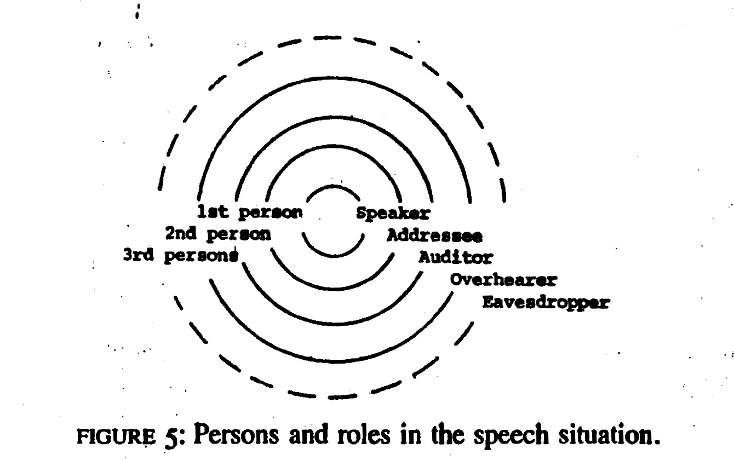
Audience Design- Bell (Bell 1984)

Slide 9
Audience Design (Reworked)- Bell
Traditionally PR spoke to the audience
The Web initially changed the potential scope of the audience for PR
The key change that Web 2.0 has brought to PR is that members of the audience can become co-creators of content for other audience members

Slide 10
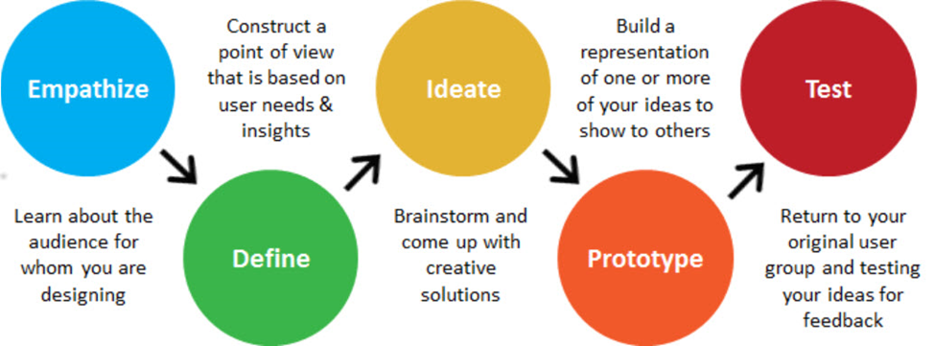
Design Thinking gives PR practitioners a framework for exploiting this change
Move towards building conversations
(Brown 2008)

Slide 11
Grice’s conversational maxims
Within these online and offline conversations, some rules have traditionally applied (these are regularly flaunted):
Maxim of quantity
Maxim of quality
Maxim of relation
Maxim of manner
Notes:
Say as much is as needed, but not more
Be truthful- we will discuss this more in the lecture on ethics
Be relevant- back to the Design Thinking framework. Think of the needs of your audience.
Be clear, be mindful of the type of language you use (think of context)
These presume that speakers are being cooperative
They are, for various social reasons, regularly flaunted

Slide 12
Introduction to communities of practice
Design Thinking links closely with the concept of Communities of Practice
‘A community of practice is a collection of people who engage on an ongoing basis in some common endeavor. Communities of practice emerge in response to common interest or position, and play an important role in forming their members’ participation in, and orientation to, the world around them. It provides an accountable link, therefore, between the individual, the group, and place in the broader social order’
Notes:
http://web.stanford.edu/~eckert/PDF/eckert2006.pdf
This is different from a neighbourhood, it is different from everyone who follows a conversation on Twitter.
Again, the focus is on reciprocity, though this does not imply that every member is equally powerful or that everyone is equally involved in the community.

Slide 13
What is the difference between a community of practice and a network?
The network aspect refers to the set of relationships, personal interactions, and connections among participants, viewed as a set of nodes and links, with its affordances for information flows and helpful linkages.
The community aspect refers to the development of a shared identity around a topic that represents a collective intention—however tacit and distributed—to steward a domain of knowledge and to sustain learning about it.
Notes:
http://wenger-trayner.com/resources/communities-versus-networks/

Slide 14
Three characteristics of communities of practice
1. The domain: A community of practice is not merely a club of friends or a network of connections between people. It has an identity defined by a shared domain of interest. Membership therefore implies a commitment to the domain.
Notes:
http://wenger-trayner.com/introduction-to-communities-of-practice/

Slide 15
2. The community: In pursuing their interest in their domain, members engage in joint activities and discussions, help each other, and share information. […] But members of a community of practice do not necessarily work together on a daily basis.
Notes:
The Impressionists, for instance, used to meet in cafes and studios to discuss the style of painting they were inventing together. These interactions were essential to making them a community of practice even though they often painted alone.
They build relationships that enable them to learn from each other; they care about their standing with each other. A website in itself is not a community of practice. Having the same job or the same title does not make for a community of practice unless members interact and learn together
http://wenger-trayner.com/introduction-to-communities-of-practice/

Slide 16
3. The practice: A community of practice is not merely a community of interest–people who like certain kinds of movies, for instance. Members of a community of practice are practitioners. They develop a shared repertoire of resources: experiences, stories, tools, ways of addressing recurring problems—in short a shared practice.
Notes:
This takes time and sustained interaction. […] nurses who meet regularly for lunch in a hospital cafeteria may not realize that their lunch discussions are one of their main sources of knowledge about how to care for patients. Still, […]they have developed a set of stories and cases that have become a shared repertoire for their practice.
http://wenger-trayner.com/introduction-to-communities-of-practice/

Slide 17
Communities of practice on twitter
The ad hoc formation of audience communities during a media event on Twitter is not a community of practice
Participants in #edchatie are members of a community of practice
Participants are educators
They come arrange to meet on Twitter to share and learn about topics in a given field
Think of how Audience Design applies to this:
How is the addressee designated?
How might participants be aware of auditors?
How might participants be aware of overhearers?
Notes:
Tannen, Deborah; Hamilton, Heidi E.; Schiffrin, Deborah (2015-04-28). The Handbook of Discourse Analysis (Blackwell Handbooks in Linguistics) (Kindle Locations 5654-5657). Wiley. Kindle Edition.

Slide 18
Social networks can create cultural capital for participants.
Bourdieu’s concept of cultural capital refers to the collection of symbolic elements such as skills, tastes, posture, clothing, mannerisms, material belongings, credentials, etc. that one acquires through being part of a particular social class […] —creates a sense of collective identity and group position (“people like us”).
.
Cultural capital is a major source of social inequality.
Notes:
According to Bourdieu, cultural capital comes in three forms—embodied, objectified, and institutionalized. One’s accent or dialect is an example of embodied cultural capital, while a luxury car or record collection are examples of cultural capital in its objectified state. In its institutionalized form, cultural capital refers to credentials and qualifications such as degrees or titles that symbolize cultural competence and authority.
http://routledgesoc.com/category/profile-tags/cultural-capital

Slide 19
Social networks
The hidden influence of social networks

Slide 20
Questions
List and explain the three characteristics of a community of practice.
How do social networks impact on cultural capital?
Why is it important to consider the place of an individual in a network for PR?
How do Audience Design and Grice’s Conversation Maxims apply to #edchatie?
How is this different to how #ictedu is currently being used?

